Slide 1

Clery Act Training for Campus Security Authorities: Sport Club Coaches September 24 and 30, 2025
Joaquin Feliciano he/him/his
jbfeliciano@ucdavis.edu
(530) 752-9050
Clery Compliance Coordinator
Office of Compliance and Policy

Slide 2
Clery Act Training for Campus Security Authorities: Sport Club Coaches
Overview of the Clery Act
Campus Security Authority (CSA) reporting responsibilities
Stop Campus Hazing Act
CSA Online Reporting Tool
Resources for CSAs and Students
Questions

Slide 3
What is the Clery Act and what does it have to do with being a Sport Club Coach?
The Jeanne Clery Campus Safety Act (Clery Act) is a consumer protection law that provides transparency around campus crime policy, response, and statistics. All colleges and Universities that receive federal financial aid funds are required to comply.
Main Clery Act compliance areas:
Publish a Daily Crime Log and Daily Fire Log
Issue Timely Warning and Emergency Notifications
Publish the Annual Security and Fire Safety Report, including crime statistics and safety policies/procedures
Identify and train Campus Security Authorities (CSAs)

Slide 4
What is the Clery Act ?
Campus Security Authorities (CSAs) are individuals or organizations with specific crime-reporting responsibilities under the Clery Act. CSAs include:
UCD Police Department employees
Non-UCDPD individuals/offices with responsibility for campus security
Individuals/offices to which, by policy, students and employees should report criminal offenses
An official of an institution who has significant responsibility for student and campus activities, including, but not limited to, student housing, student discipline, and campus judicial proceedings…
Student Housing Resident AssistantsChancellor and Department Heads
ICA Coaches and Trainers
Most Campus Rec staff
Sport Club Coaches

Slide 5
What are my responsibilities as a CSA?
Report any Clery Act crime or incident that occurred within UCD’s Clery Act geography immediately or as soon as reasonably practicable after witnessing or learning of the incident.

Slide 6
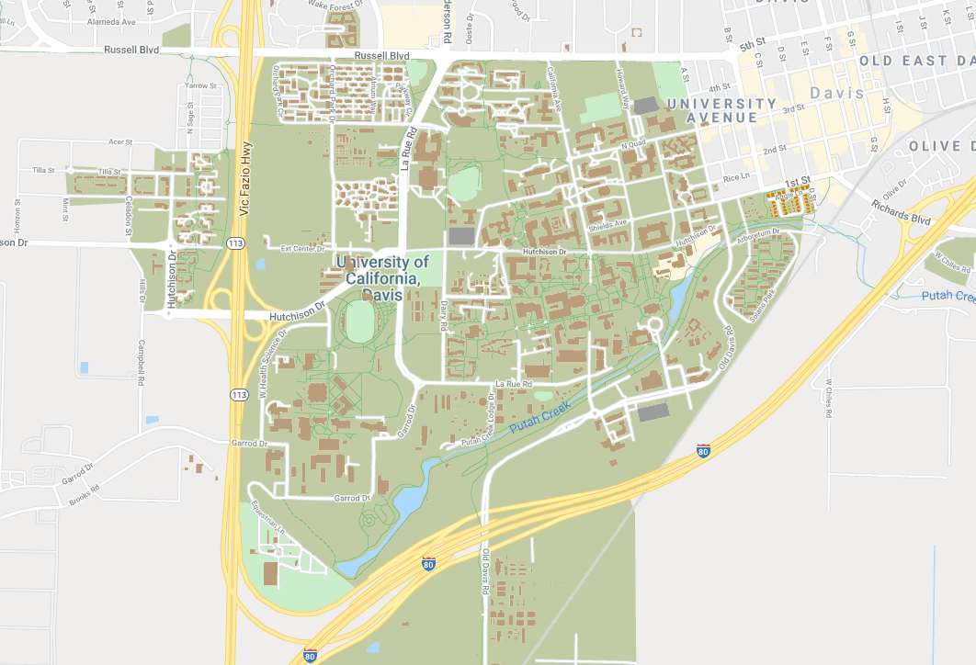
What is UCD’s Clery Act Geography?
UCD’s Clery Act geography includes:
Davis or UCD Health campus property
Public property immediately adjacent to the Davis or Health Campus
Any off-campus location rented/owned by UCD, including practice facilities, paid lodging (>2 nights), and sorority/fraternity Chapter houses

Slide 7
What are Clery Act crimes?
Murder / Manslaughter
Rape
Fondling
Incest
Statutory Rape
Robbery
Aggravated Assault
Burglary
Motor Vehicle Theft
Arson
Any of the above crimes, PLUS larceny, simple assault, intimidation, destruction/vandalism
IF they also include evidence that the victim was intentionally selected because of the perpetrator’s bias against the victim’s race, gender, gender identity, religion, sexual orientation, ethnicity, national origin, or disability.
Domestic Violence, Dating Violence, Stalking
Arrests or Disciplinary Referrals for Weapons/Drug/Liquor Law Violations
HAZING

Slide 8
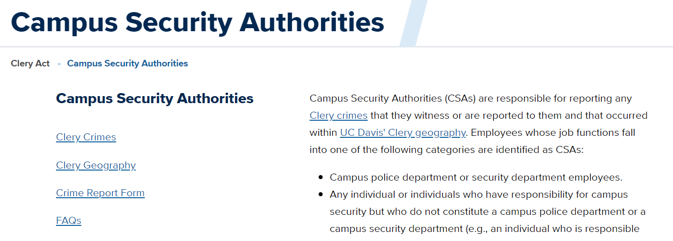
What are Clery Act crimes?
Clery Act crimes, abridged:
Violent crimes, including Sexual Violence and Relationship Violence
Theft and Arson
Weapons/Drugs/Alcohol
Targeted Hate Crimes
Hazing
Not sure if it’s a Clery crime on UCD’s Clery geography?
Report it
Ask Joaquin
jbfeliciano@ucdavis.edu or 530.752.9050
clery.ucdavis.edu/csas

Slide 9
Hazing
Hazing is defined as any intentional, knowing, or reckless act committed by a person (whether individually or in concert with other persons) against another person or persons regardless of the willingness of such other person or persons to participate, that—
(I) is committed in the course of an initiation into, an affiliation with, or the maintenance of membership in, a student organization; and
(II) causes or creates a risk, above the reasonable risk encountered in the course of participation in the institution of higher education or the organization (such as the physical preparation necessary for participation in an athletic team), of physical or psychological injury, including…

Slide 10
Hazing
whipping, beating, striking, electronic shocking, placing of a harmful substance on someone’s body, or similar activity;
causing, coercing, or otherwise inducing sleep deprivation, exposure to the elements, confinement in a small space, extreme calisthenics, or other similar activity;
causing, coercing, or otherwise inducing another person to consume food, liquid, alcohol, drugs, or other substances;
causing, coercing, or otherwise inducing another person to perform sexual acts;
any activity that places another person in reasonable fear of bodily harm through the use of threatening words or conduct;
any activity against another person that includes a criminal violation of local, State, Tribal, or Federal law; and
any activity that induces, causes, or requires another person to perform a duty or task that involves a criminal violation of local, State, Tribal, or Federal law.

Slide 11
Hazing
“Student organization” means an organization at an institution of higher education (such as a club, society, association, varsity or junior varsity athletic team, club sports team, fraternity, sorority, band, or student government) in which two or more of the members are students enrolled at the institution of higher education, whether or not the organization is established or recognized by the institution.

Slide 12
Reportable?
A member of the Crew Team reported that, while stopping to buy gas in East Davis on the way home from morning practice, they were carjacked at gunpoint. The perpetrators also stole the team member's wallet and smartphone.
Clery crimes, abridged:
Violent crimes, including Sexual Violence and Relationship Violence
Burglary, Motor Vehicle Theft, Arson
Weapons/Drugs/Alcohol
Targeted Hate Crimes
Hazing
Clery Geography, abridged:
On or touching campus
Owned or controlled by UCD, used by students
Temporary stay by UCD students

Slide 13
Not Really Reportable* Clery crime; Not in Clery geography
A member of the Crew Team reported that, while stopping to buy gas in East Davis on the way home from morning practice, they were carjacked at gunpoint. The perpetrators also stole the team member's wallet and smartphone.
Clery crimes, abridged:
Violent crimes (Robbery), including Sexual Violence and Relationship Violence
Burglary, Motor Vehicle Theft, Arson
Weapons/Drugs/Alcohol
Targeted Hate Crimes
Hazing
Clery Geography, abridged:
On or touching campus
Owned or controlled by UCD, used by students
Temporary stay by UCD students

Slide 14
Reportable?
A first-year undergraduate student and new member of the Crew Team informs the club’s coach that they missed yesterday’s morning practice because they had to participate in a lock-in at the Zeta Zeta sorority Chapter House with the rest of the new pledges that involved staying up all night cleaning the entire Chapter House, playing drinking games, and serving breakfast to the sorority officers.
Clery crimes, abridged:
Violent crimes, including Sexual Violence and Relationship Violence
Burglary, Motor Vehicle Theft, Arson
Weapons/Drugs/Alcohol
Targeted Hate Crimes
Hazing
Clery Geography, abridged:
On or touching campus
Owned or controlled by UCD, used by students
Off campus, but controlled by UCD, and used by UCD students

Slide 15
Reportable!
A first-year undergraduate student and new member of the Crew Team informs the club’s coach that they missed yesterday’s morning practice because they had to participate in a lock-in at the Zeta Zeta sorority Chapter House with the rest of the new pledges that involved staying up all night cleaning the entire Chapter House, playing drinking games, and serving breakfast to the sorority officers.
Clery crimes, abridged:
Violent crimes, including Sexual Violence and Relationship Violence
Burglary, Motor Vehicle Theft, Arson
Weapons/Drugs/Alcohol
Targeted Hate Crimes
Hazing
Clery Geography, abridged:
On or touching campus*
Owned or controlled by UCD, used by students
Off campus, but controlled by UCD, and used by UCD students*

Slide 16
How do I make a CSA report?
In an emergency, call 911 or, if on campus, 530.752.1230
Record basic information
What occurred, when and where did it occur
Do not investigate further
Inform/Remind the student you may be required to make a CSA report
Do not promise complete confidentiality
However, it’s the victim’s choice whether to disclose their identity.
Submit a CSA Online Report Form
https://ocpweb.ucdavis.edu/csa/
Includes a link to a downloadable offline report form for coaches without UCD accounts. Completed form gets emailed to Joaquin
Consider additional reporting responsibilities

Slide 17
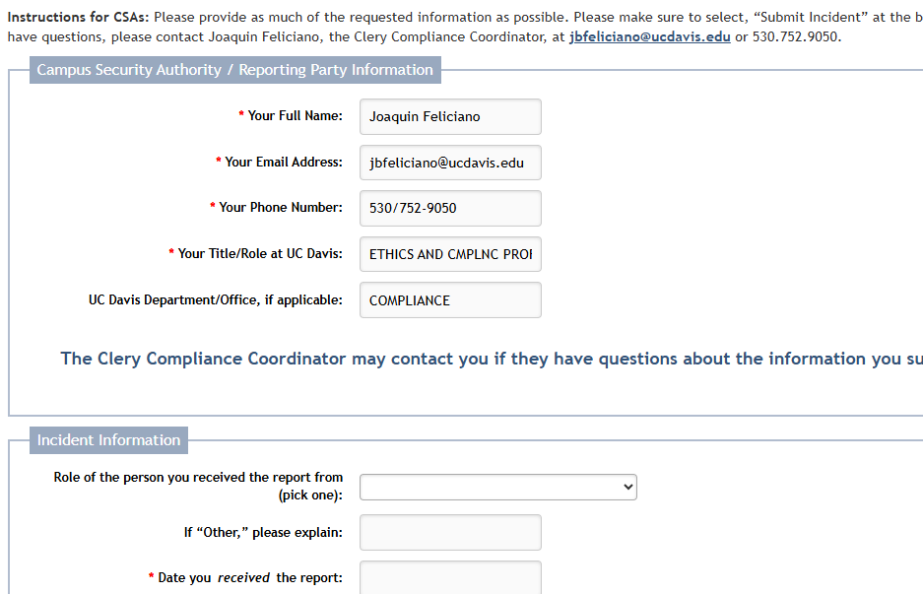
How do I make a CSA report?

Slide 18
Resources for CSAs and Athletes
Student Health and Counseling Services (SHCS)*
shcs.ucdavis.edu
530.752.2349
Center for Advocacy, Resources, and Education (CARE)*
care.ucdavis.edu
530.752.3299
Ombuds Office*
ombuds.ucdavis.edu
530.219.6750
Academic and Staff Assistance Program (ASAP)*
www.hr.ucdavis.edu/departments/asap
530.752.2727
Office of Student Support
studentsupport.ucdavis.edu
530.752.1128
Joaquin Feliciano, Clery Compliance Coordinator
jbfeliciano@ucdavis.edu
530.752.9050

Slide 19
Take Aways and Questions
As CSAs, sport club coaches are required to report Clery Act crimes that occurred on UCD’s Clery Act geography to the UCDPD.
Inform athletes of this responsibility early in the season.
Remember to share support resources
If you’re not sure whether something is reportable:
Report it at https://ocpweb.ucdavis.edu/csa/
Ask Joaquin at jbfeliciano@ucdavis.edu or 530.752.9050
UCD Clery CSA website: clery.ucdavis.edu/csas
CSA vs other reporting responsibilities
Thank you!

