Slide 1
UNIVERSITY OF CALIFORNIA, DAVIS
Club Sports
Coaches Training
2025 - 2026

Slide 2
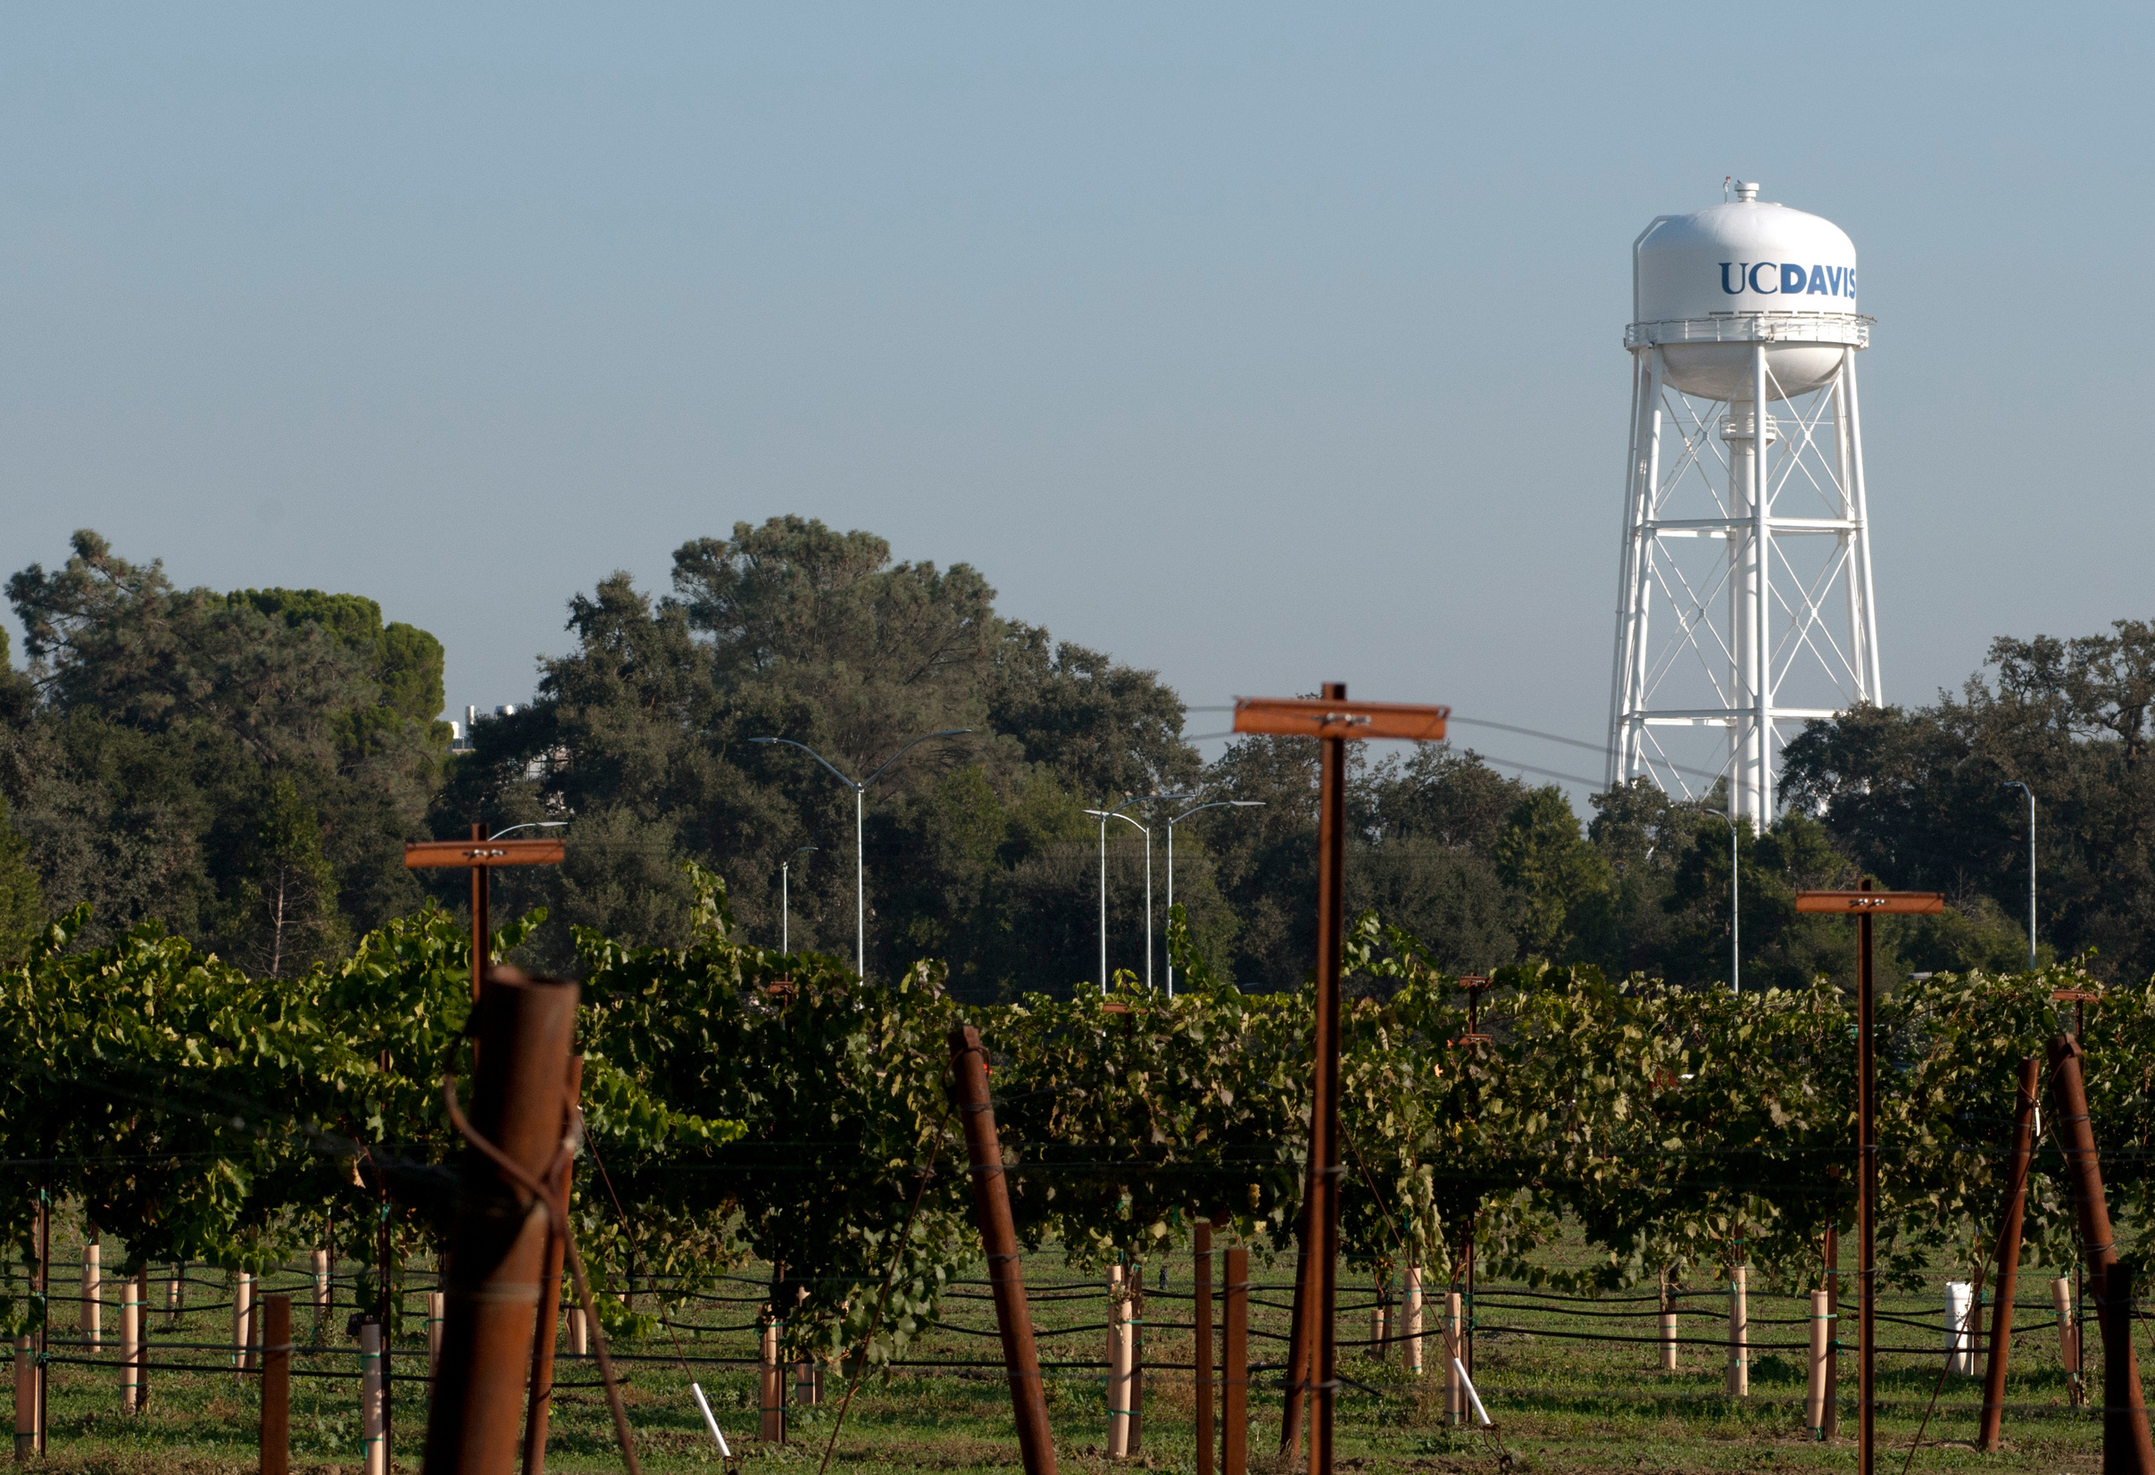
Pro Staff:
Deb Johnson
Olivia Raxter
Ben Dao
Abby DeLa’O
Shannan Rowe
Cameron Motz
Executive Director, Campus Recreation
Director
Assistant Director
Club Sports Coordinator
Head Athletic Trainer
Athletic Trainer

Slide 3
Zero Tolerance Policy
Club Conduct
Students, by participating in the Sport Clubs program, agree to conduct themselves and their organizations in an appropriate manner. Individuals must always act as University representatives, both on and off the field of play. Failure of Sport Clubs and individuals to adhere to a responsible standard of conduct will result in disciplinary action set forth by a Coordinator.
Hazing Policy
It is against the law for student organizations to conduct “Hazing.” Violation may result in loss of Sport Clubs’ status, action by Student Judicial Affairs, and/or referral to local law enforcement agencies.
Absolutely no hazing in any shape or form
Stop Hazing Google Drive
Stop Hazing UCD Page
Link to Full handbook HERE

Slide 4
Consenual Relatioship Policy
A consensual relationship that might be appropriate in other circumstances is inappropriate when it occurs between a non-student staff member or volunteer of the Department of Campus Recreation and a student. Consensual relationships between a student and an employee or volunteer who has oversight, evaluative, or advisory responsibilities over the student is prohibited.
In addition, conflicts of interest created by consensual relationships in employment or education may lead to charges of sexual harassment brought by third parties who believe the consensual relationship creates a discriminatory environment.
CRU recognizes that a consensual relationship may exist prior to the time an individual is assigned to a supervisor, instructor or coach. An individual shall not accept supervisory, decision-making, oversight, evaluative, coaching or advisory responsibilities over a student with whom he or she has a consensual relationship.
The Department of Campus Recreation has the right and obligation to protect the club by relieving any coach/instructor from their position if they are not deemed to be working in the best interest of the club, the Department of Campus Recreation, or the University. The dismissal of the coach/instructor is not subject to appeal.

Slide 5
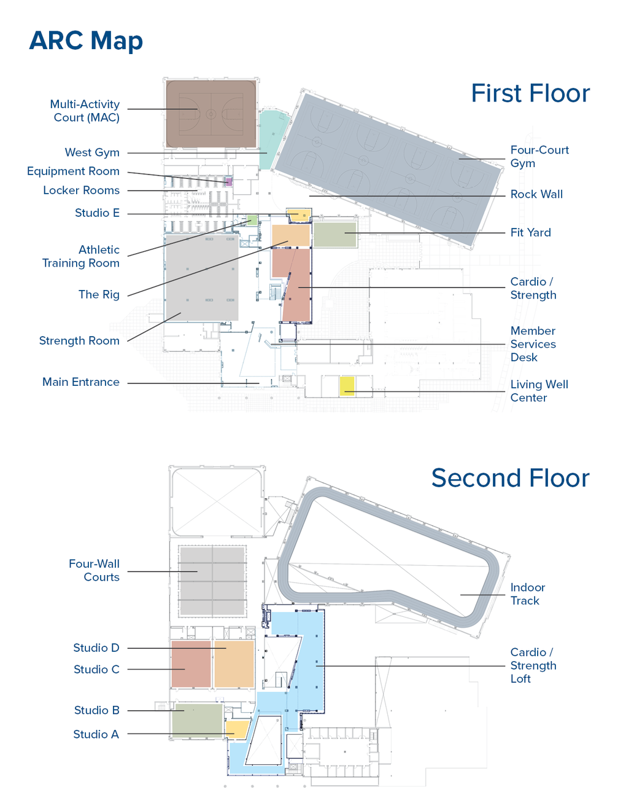
Campus Rec Offices
Mailing Address:
232 ARC
One Shields Ave.
Davis, CA. 95616
Location:
2nd floor of ARC
Office hours:
9 AM- 4 PM
Mon-Fri

Slide 6

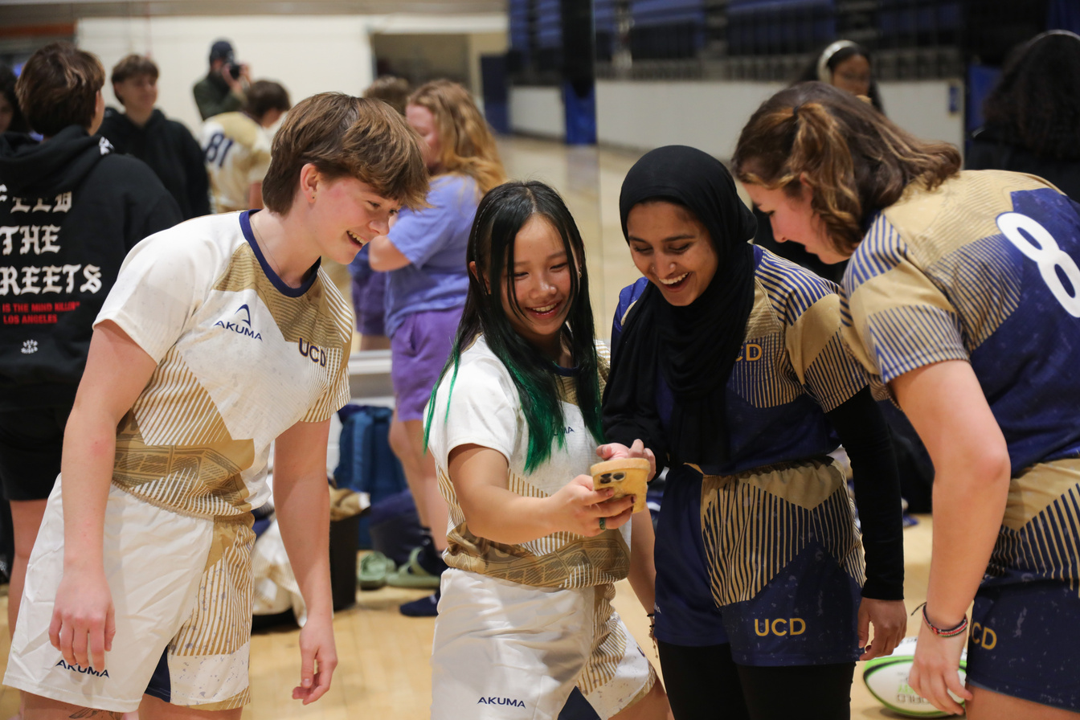

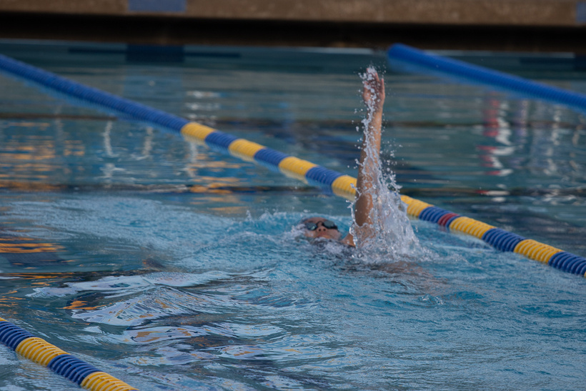
Duties and Expectations
Responsible for skill improvement, workouts, game strategy, and other coaching decisions
Help to ensure good sportsmanship at all times and always conduct themselves in a positive matter to represent UC Davis
Adhere to all UC Davis, CR, and Sport Clubs policies and procedures
You take over at practices and games, but everything is run through the student leaders!

Slide 7
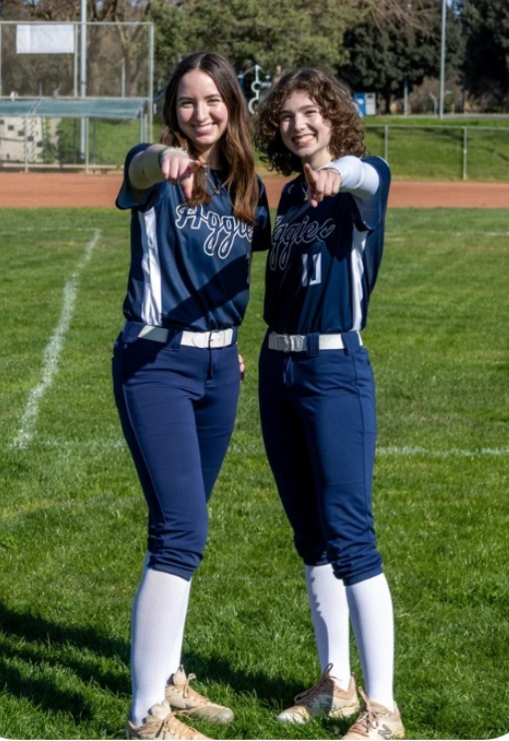
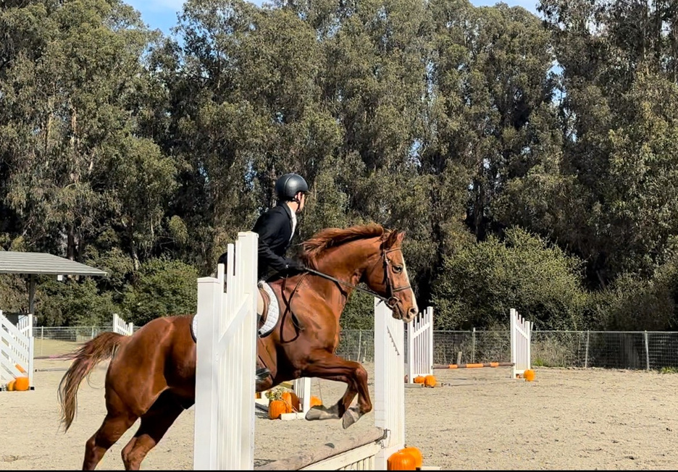
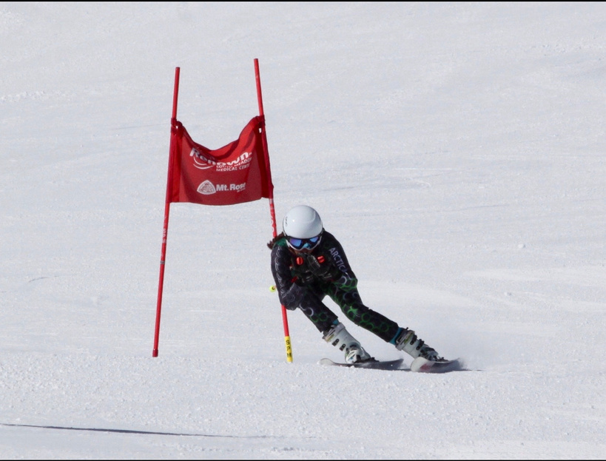
What is a Sport Club?
An extracurricular program for tuition paying students; a privilege not a right
Built and led by the student officers
A competitive outlet where they learn critical professional development skills

Slide 8
Managers
General Duties :
Establish a relationship with each assigned sport club and its officers
Coordinate practice schedules for each club with the help of the Sport Club Coordinator
Ensure the club’s daily operations function within the guidelines set forth by the Sport Club program
Ensure clubs are attending mandatory officer’s and coach’s trainings
Recognize and deal with potentially volatile teams early in the year
Assist with coordinating both in-state and out-of-state travel for each club assigned
Organize any tournaments held on campus by the team
Ensure club’s knowledge of their bank accounts (all types)
Ensure all club members are signed up on Fusion and have paid for mandatory liability insurance
Ensure potential drivers have submitted their License and Proof of Insurance before operating a vehicle with other Sport Club participants as passengers
Actively communicate with clubs throughout the quarter
Actively communicate with the Sport Club Coordinator should any problems or pressing questions arise
Hosting Club meetings monthly

Slide 9
Other Student Employees:
Supervisors:
On field contacts for practices, games or events
CPR/AED and blood pathogen trained
Unlock/lock faciltiies, help with equipment
Help keep the flow of the event going
Recorders:
In office admin
Help approve atheltes on DSE
Answer phone/email
Approve travel and drivers
Book fleet reservations

Slide 10


Getting Started and Setting your team up for SUCCESS!

Slide 11

Align your expections with the clubs before the season starts
We recommend coaches and players contracts
Confirm practice and scheduling
Athletic and non-athletic team goals?
No show/no play policy?
Payment for traveling/games/practices?

Slide 12
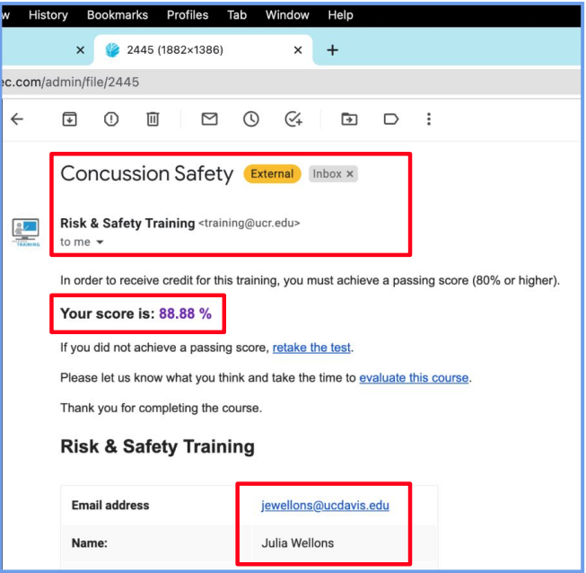
Do Sports Easy (DSE)
Fusion fee (paid through rec portal)
NO MORE 2 WEEK WAIVER
Regardless of tryouts, trial periods, etc. all anticipated club members must sign up on fusion and pay admin fee
can request refund if they don't join the club
Baseline Concussion Test
high impact clubs only
Physical signed and completed by NP, PA, MD
1 and done
Can’t compete until completed
Concussion Safety Training
Every file must show the
following:
- Test Name
- Name and/or Email
- A passing score of 80% or above

Slide 13

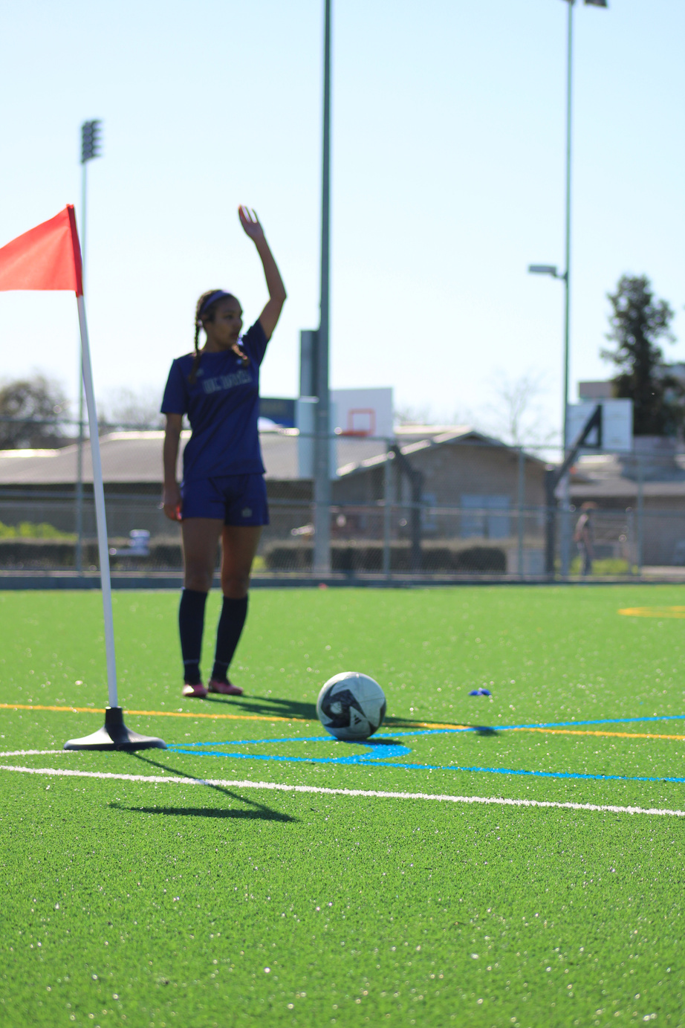
Becoming a Driver
Send a picture of driver’s license and current insurance to sportclubs@campusrec.ucdavis.edu
Wait for approval (it may take at least a week for us to get records back)
*For Out-of-state licenses you have to
request a pull notice (driving records) from
your home state DMV and send it to
screcordermanager@gmail.com

Slide 14
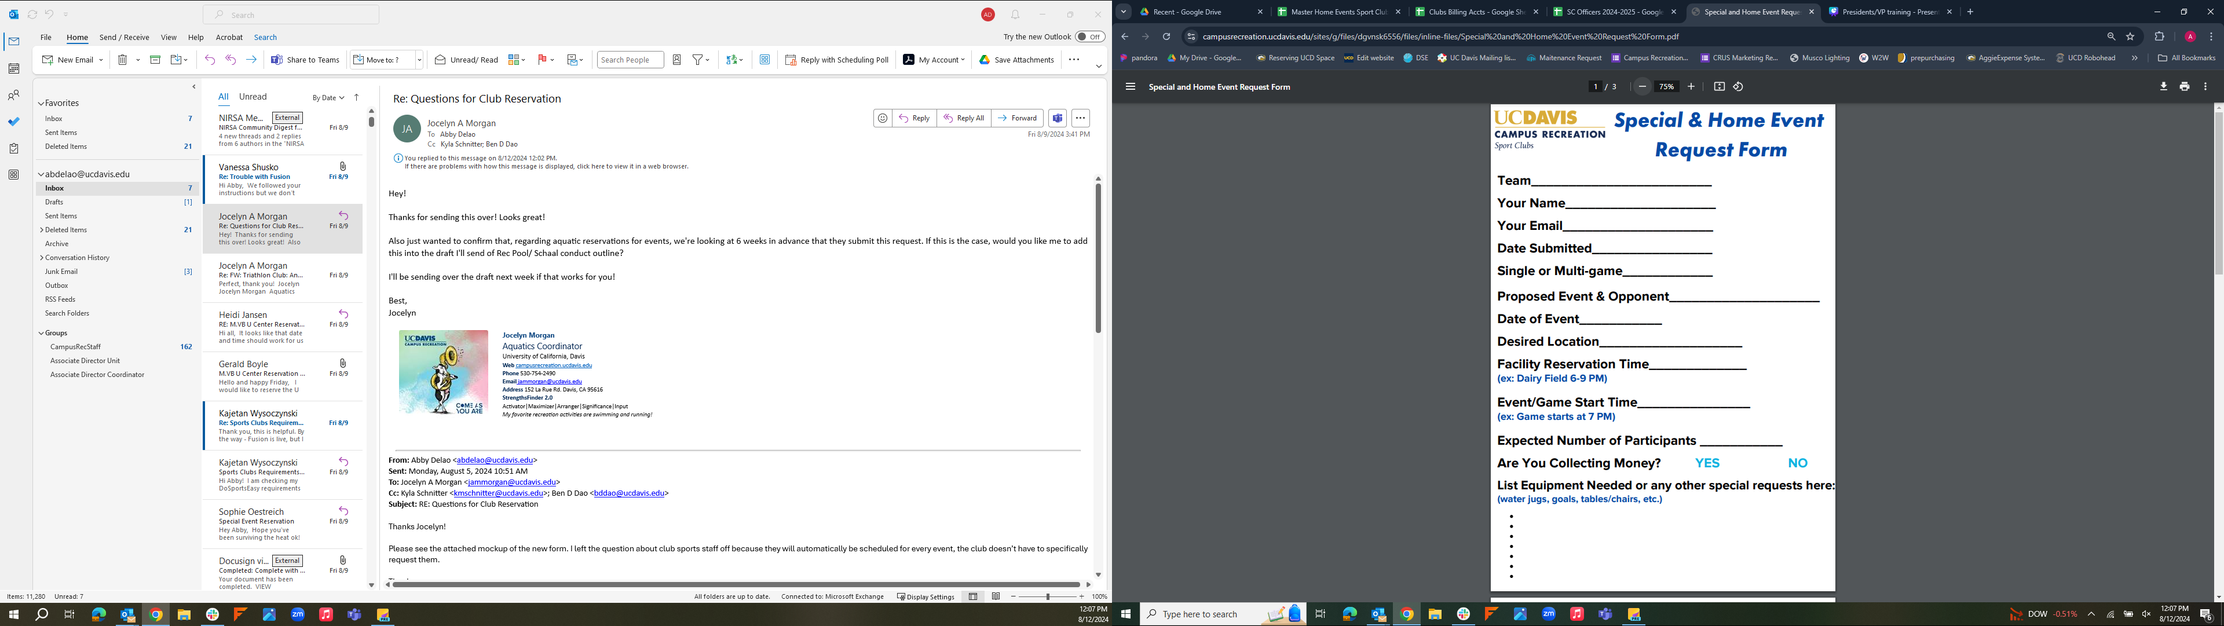
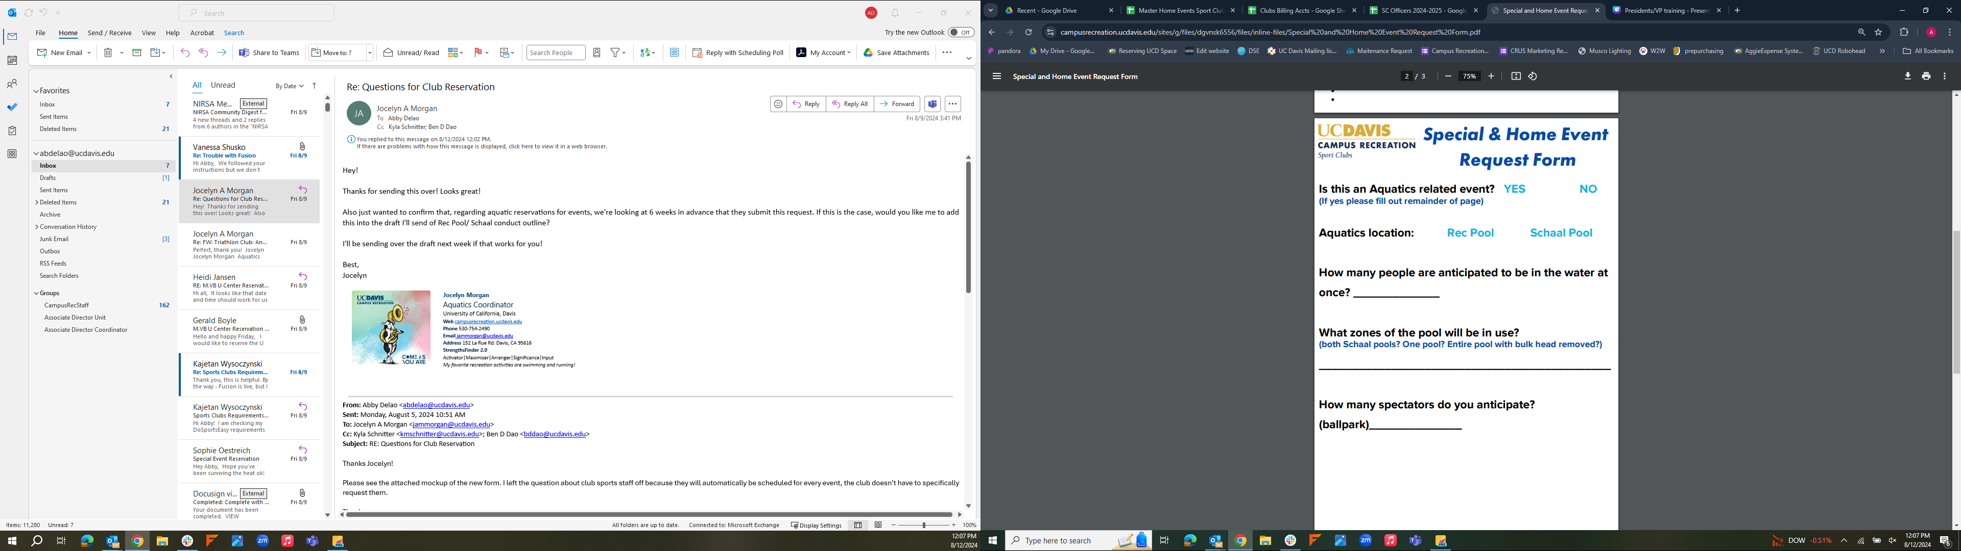

Requesting Home games/Special Events
New section to fill out for pool/Aquatic related inquires- pool events MUST be requested a minimum of 6 weeks in advance
Must be submitted at least 2 weeks in advance from event date

Slide 15
Things to be aware of as a Coach:
Discrimination and harassment
Sexual violence and assault
Hazing
https://stophazing.ucdavis.edu/what-to-do
Stop Hazing
Alcohol/Drug Abuse
Concussions
YOU ARE A MANDATED REPORTER

Slide 16
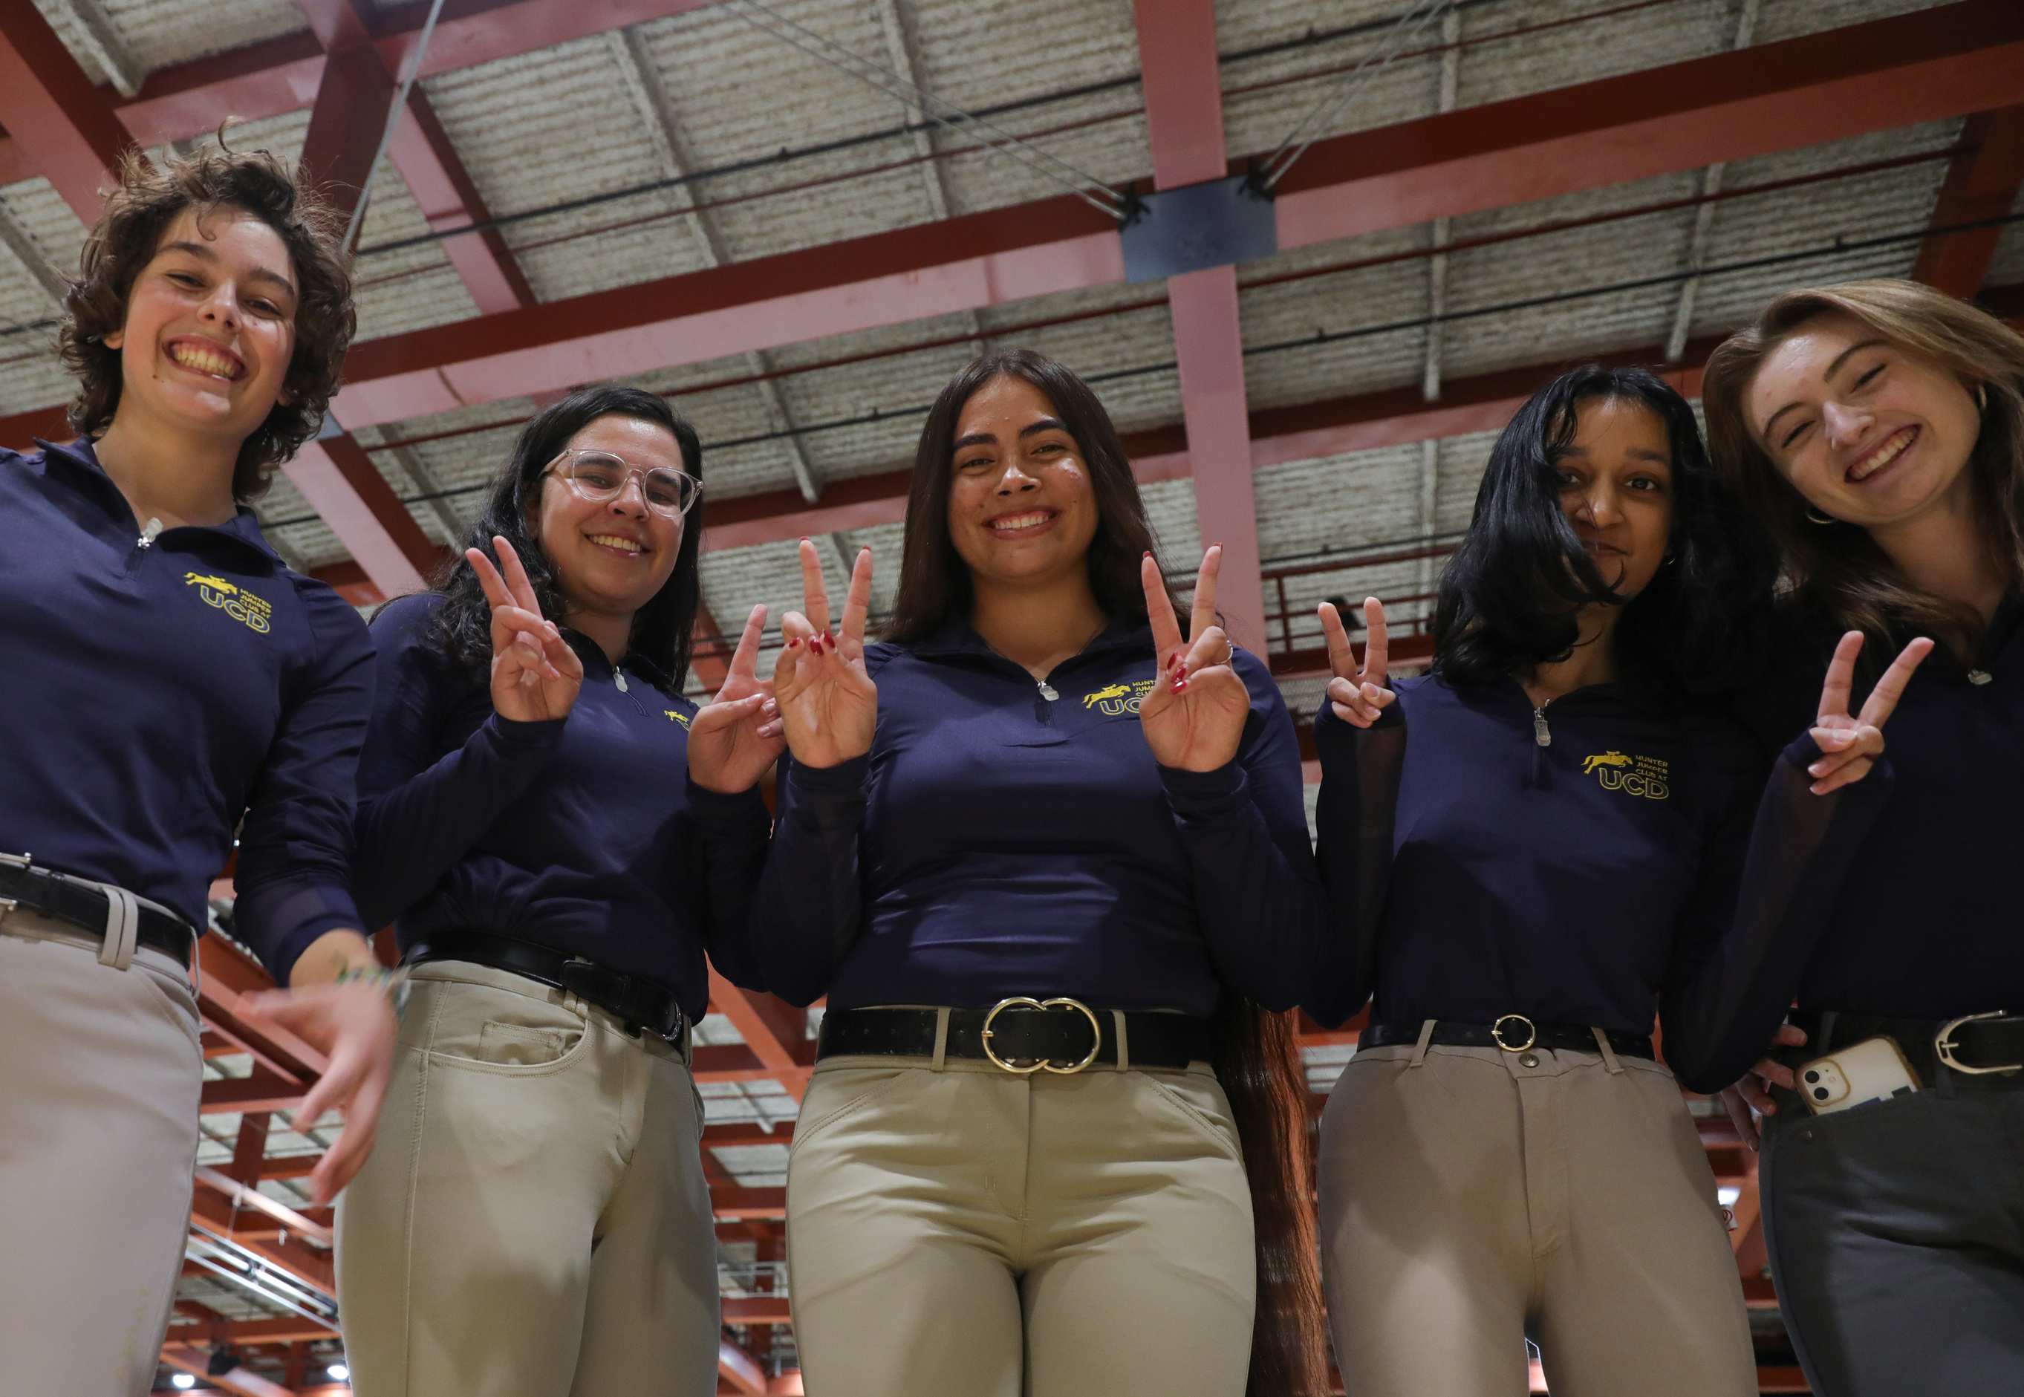
What’s Coming Up...

Slide 17
Coaches need to complete background check (submitted for you by CR Dept.)
Login to Praesidium to complete training asap!
Complete Docusign of coaches paperwork
Complete Concussion Training: https://uctraining.wufoo.com/forms/z1rgubtq1gya1fm/
If you or club hasn’t already please email me your contact information!
abdelao@ucdavis.edu

Slide 18
Due Dates for Clubs
All due dates are located in the sport clubs handbook in the calendar section on the Officers Resource page of the Campus Rec Website
Missing/late forms will result in fines for your club!
Due by 3 PM on 10/24:
1. CPR/AED/First Aid & Concussion certifications due
2. Practice Requests for Winter 2026 due
3. Constitutions due
4. Physicals, Fusion, DSE due
5. Sport Club Advisory Council Applications Due

